Slide 1
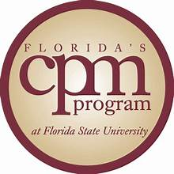
Making the Most of your CPM as a Professional Credential
Rev: 7-12-26
Lynn Chisholm, MS, CCC-SLP, CPM
FSU CPM Faculty Instructor

Slide 2

CONGRATULATIONS! You’ve earned your CPM
Now what?
How to get the most out of your CPM designation
Properly listing it on your
resume
Putting your digital badge to
work
Using the CPM for professional
education credit
How it can earn academic credit
Networking and more…

Slide 3

First, WHY did you do this (CPM) and what did you get from it?
Before putting your CPM out in the world, you may want to reflect on this question.
What’s your CPM story?
How have you integrated CPM into your leadership practices?
Why would you (presumably you would) recommend CPM to others?
And, what’s next?

Slide 4

Your CPM Designation
It is a DESIGNATION – meaning that you completed more work to earn this than a “certificate program” requires. 300 contact hours via experiential learning, including exams and evaluated work products.
A certificate – is one and done. Earned for completing a skill training. Example, a certificate in Microsoft PowerPoint, or attending a professional workshop.
The CPM designation - is a formal, industry-recognized professional title granted in accord with our National Accreditation association (NCPM) that proves you have mastered an entire job role (public manager).

Slide 5
Value and Share your CPM
In your signature line – Your Name, CPM
If you have other credentials, you may list them in order, with degree first, e.g., Your Name, MBA, PMP, CPM
On your resume – either under education or professional development, formatted as you wish:
EDUCATION
Florida State University, Tallahassee, FL August 2009
Certified Public Manager Program (CPM) Designation
- OR -
PROFESSIONAL DEVELOPMENT
Certified Public Manager Program (CPM) Designation, Florida State University, Tallahassee, FL, August 2009.

Slide 6

A little unsolicited advice from your “Auntie Lynn”…
Why? Because….
I’ve listened to hundreds and hundreds of employers and hiring agents talk about what they are looking for. And you’d be surprised about the similarities across industries.
I’ve read and edited hundreds and hundreds of resumes. Trained managers on how to hire.
I’ve been offered the job for every job I’ve applied/interviewed for – 10 in my professional life.
I’ve shifted careers/changed industries – from private to public, from healthcare to higher education to local government and back to higher ed (in a different field).
I’ve worked in 3 different states, 6 different cities, and now travel the state listening to potential employers.
I’ve spent 8 years in the career readiness/development work-space focused on career success.

Slide 7
So… About your resume…
Tailor your resume for any opportunity you submit it for – to match the position, reflect requirements, and echo descriptors.
Use a traditional format (functional resumes are not that functional.)
Edit it and have someone else look it over too. No errors. Nope, none.
It should be clear and concise and laser-focused on how you meet the requirements of the position. Don’t make them work for it.
Do include your competencies. If you want/need to display your skills, you can build a web site/e-portfolio and provide the link on your resume.
Do prioritize the importance of your bullets as they may relate to the position you’re seeking, but limit bullets to 5-7.
Create a personalized (i.e., real and not AI) Professional Statement.
Professional content only – leave off your college job at Applebee’s.

Slide 8

Oh, and real quick hon . . .
Image (brand) is everything.
Do not use your photo on your
resume.
Include a professional email address (not hotgirl10of10@gmail.com).
Include a phone number with a professional voice mail message (not, “Yo, who dis? Do what you do. We out!)
Don’t include your address at this point*.
Build up your “professional digital footprint” – LinkedIn.
If you interview, dress with logo colors – tie, blouse, anything.
Remember that the classics never go out of style.

Slide 9
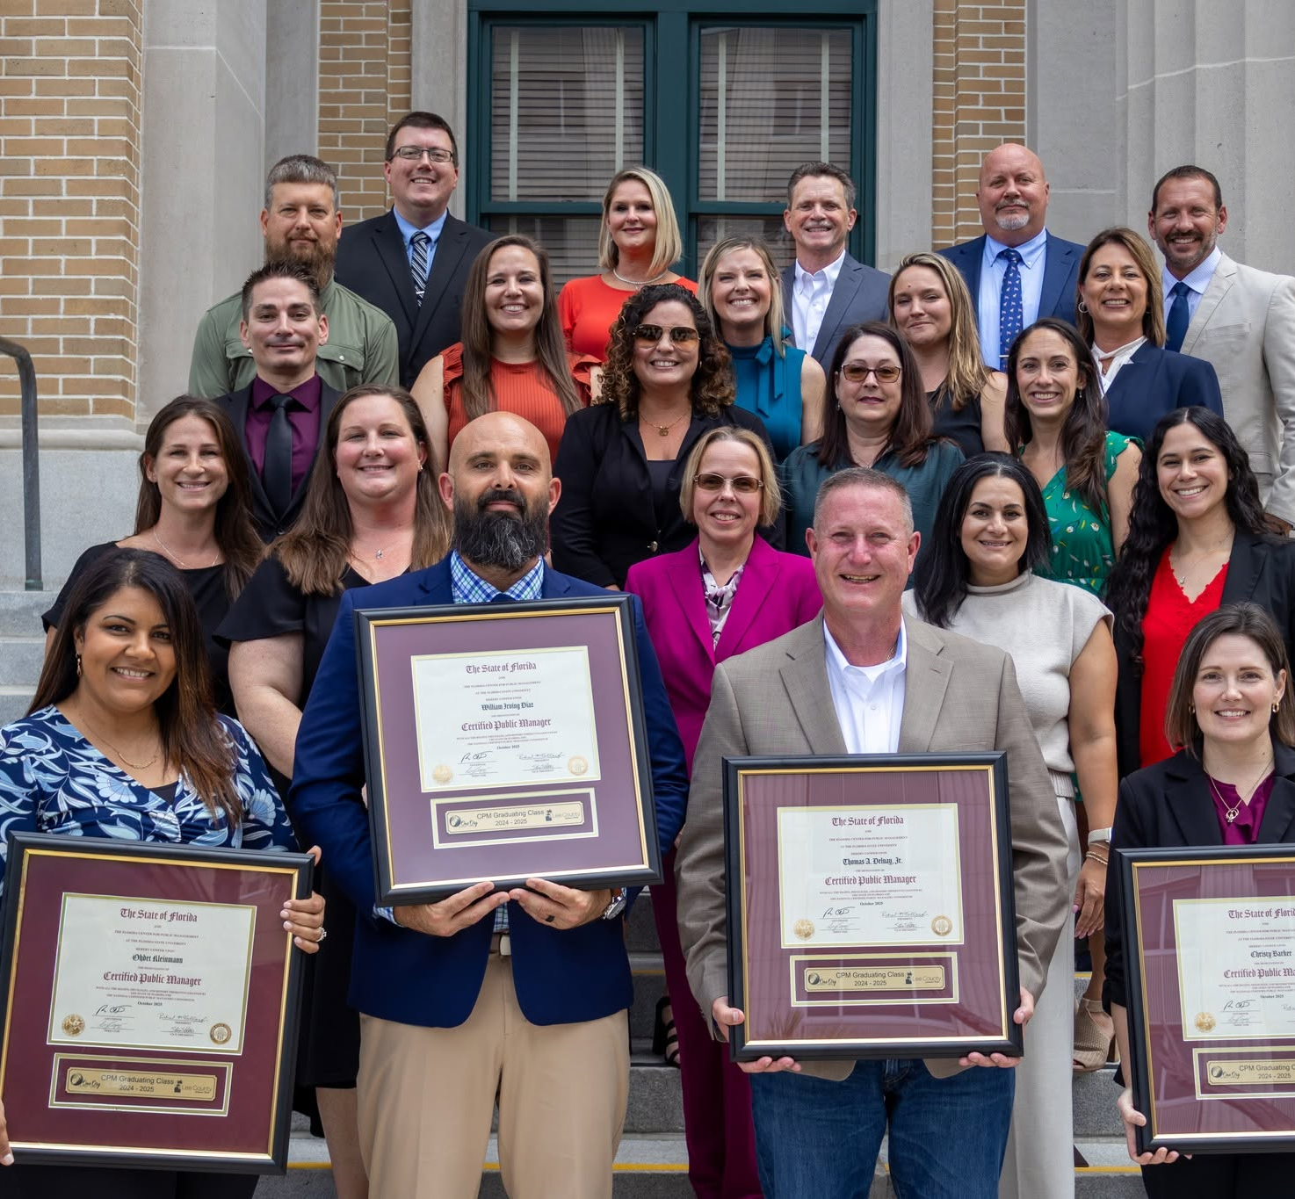
So, what’s next?
How will you promote your CPM?
How will you use your CPM?
What goals will it help you to achieve?
How will you network with others in your agency with the CPM?
Who will you send next?

Slide 10
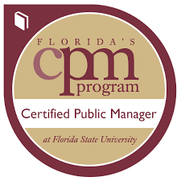
The FCPM Graduate Badge
Easy Next Step!
This is a digital micro-credential that can be used on any digital platform: LinkedIn, email signature, any Social Media…
Encrypted with earner/issuer (you/us) and non-transferrable.
Credly is our partner and offers instructional videos on using the badge. You’ll get an email with instructions after Level 8.
Add #FCPM so we can find you!

Slide 11

Share your CPM on LinkedIn
Share your CPM Graduate Badge
with a personal comment (Credly
offers a standard message, but
you can do better!)
Search for other FCPMs to expand
your network. Add #FCPM when you
post so other CPMs can find you.
Build connections.
Enhance your network. Post interesting articles, comment on other’s posts in an insightful way.
Building your LinkedIn profile and using it keeps it active.

Slide 12

Professional
Development
Credit
CE credits (Continuing Education) aka PDUs (Professional Development Units) may be required to maintain your licensure or professional certifications.
In addition to the industry-specific continuing ed units, your license or certification may allow for related credits, such as in leadership.
Let’s look at how to go about getting CEUs for your CPM work, and what you may need to do it.

Slide 13

Using CPM for CE Credits
Timely: It needs to be requested/submitted for the year in which you earned your CPM and for that year of renewal.
Form: Your licensure/certification Board (website) has a form for you to complete in order to apply your CPM for credits. It will ask for the information needed as well as any documentation to provide.
Documentation: You may need your CPM
transcript (you can download it from the
FCPM website), a photocopy of your CPM
certificate, and/or other documentation
to verify what you have completed.
If it is just one Level, you may need to
provide a copy of your exam or assignment.

Slide 14
Things you’ll need to check through your Board
Provider approval: Training providers must be approved. Since CPM is a part of FSU this should not be a problem.
  CPM can’t apply for pre-approval. There are too many different forms of licensure and professional certificates to cover.
Content relevance: The course must relate to your license area of practice. You may have an option for “other” credits, such as “leadership” but it depends on your credential.
Hours and format: You may have specific types of required hours per renewal period.
  The conversion rate is 10 contact hours = 1 CEU.
  1 CPM Level is roughly 24 contact hours.
Documentation: In addition to CPM records, you may also need to provide copies of your submitted/graded papers to verify that you passed if using only one Level.

Slide 15
CE or PDU Resources you might need
CEU (Continuing Education Unit) Calculator - Calculator Academy – to calculate contact hours to CEUs.
Continuing Education Credits - Everything You Need to Know - Pathways to Advancement
Licensing Portal - CE Searches – FL Licensure Board
www.aspanet.org –American Society for Public Administrators
www.fscpm.org – Florida Society of Certified Public Managers
FSCPM Consortium – October 1 & 2, Plant City

Slide 16

Using CPM for Academic Credit
Not that I don’t know… I do, but I don’t know if it will apply to your academic needs. It’s complicated.
The “easy way” is no longer an option due to SACs Accreditation. It wasn’t anything we could change. (P.S., it was also complicated.)
Let’s look at how to go about getting “prior learning” academic credit for your CPM work, and what you may need to do to earn it.

Slide 17
The route is a Prior Learning Assessment ePortfolio
Institution: Not all institutions accept an ePortfolio as a route to course equivalency. State Colleges and Private Colleges are able to offer a PLA option if you are seeking a degree there.
Course: The ePortfolio is constructed to represent evidence of meeting the learning objectives for a specific course, and only for an undergraduate level course.
Assessment: The completed ePortfolio is submitted for faculty approval and evaluated based on the course objectives for credit. (CPM was pass/fail, your work must equate with a letter grade for academic credit.)
ePortfolio Format: It is a robust catalogue of documentation of how the learning enabled the learner to demonstrate knowledge of the course content.

Slide 18

PLA Resources you might need
https://www.americanprogress.org/article/prior-learning-assessments/
https://www.acenet.edu/Pages/default.aspx
https://www.americanprogress.org/
https://www.cael.org/
Search CAEL’s CPL – provider
network, or search your
college’s website for PLA to see
if it is an option.
This ePortfolio thing is a lot of work.

Slide 19
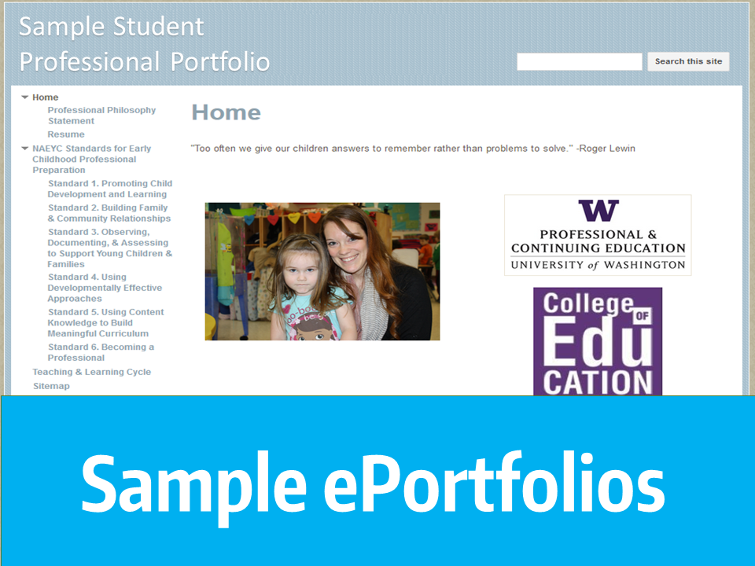
E-Portfolio for PLA
Florida Gulf Coast University
Miami-Dade College
Polk State College
Broward College
Eastern Florida State College
PLA e‑portfolio typically includes:
Clear cover page and table of contents
Course or program outcomes you are addressing
Narrative explaining how your experience matches those outcomes
Evidence (work samples, projects, reports, presentations)
Resume and skills inventory
Organized, tabbed structure for easy assessor access

Slide 20
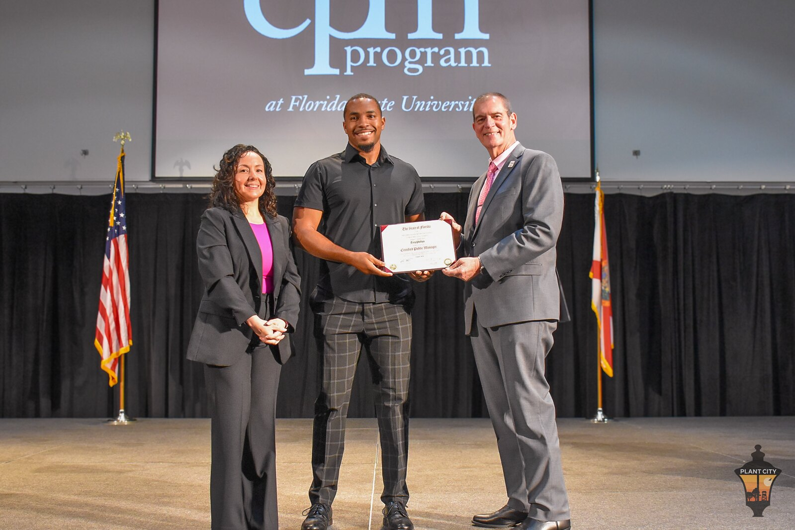
Branding using your CPM
The credential is one thing, but living it is another.
How many (unfortunate) times have you heard someone say, “they have the CPM, but they don’t use it”?
One value of the CPM credential is having toolkit of resources, but the real key is using it.
Let’s look at how we can use the CPM to enhance our brand.

Slide 21
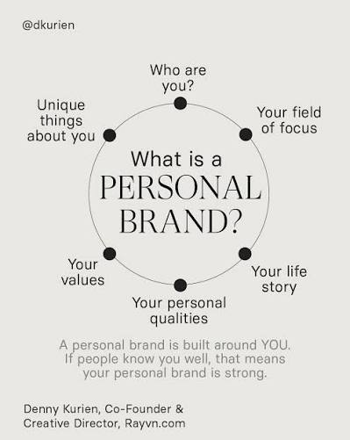
Align Your Professional Brand with the CPM
Identify Your Strengths and Values: Take
inventory of your skills, achievements, and
professional priorities.
Craft Your Message: Develop a clear value
proposition that communicates what you
bring to the table.
Maintain Consistency: Ensure your online
presence, communications, and professional
behavior consistently reflect your brand.
Showcase Expertise: Share insights, case studies,
or thought leadership content to demonstrate
knowledge and credibility. (LinkedIn is one way.)
Seek guidance through a Mentor: Feedback and
insight through someone further down the path can help.

Slide 22
The CPM designation does not expire… but
There are some character and behavior assumptions when you’ve earned a leadership credential.
…That you will continue your growth as a manager and leader, and as a reflective practioner.
…That you will perform in alignment with the credential’s values and targeted outcomes – use it as your touchstone.
…That you will perform as a transformational leader, and that it wasn’t about “winning”, it was about learning, and serving.
…That you will send the elevator down for the next person.

Slide 23
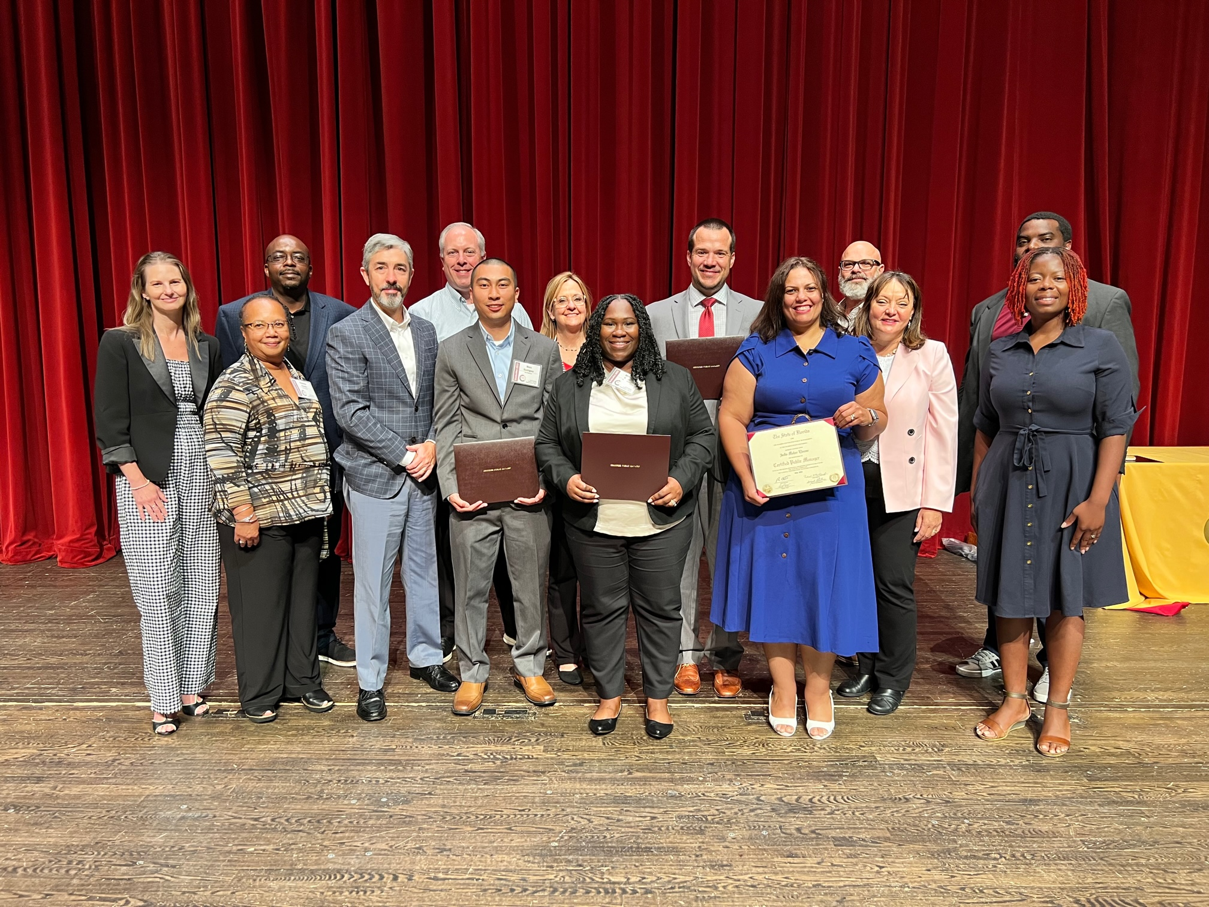
Now, put it all together!
What does your action plan look like?
Let’s start with some easy steps:
Walking at graduation is step 1.
Sharing your badge is step 2.
And, once again, what’s next?
Don’t forget, the Level 7 Executive Growth
Plan assignment it can be magic if you work it!

Slide 24

Discussion? Questions?
CONGRATULATIONS CERTIFIED PUBLIC MANAGERS!
You’ve got this – just remember that a goal
happens as long as we keep working it!

