Slide 1

CONGRATULATIONS … … on earning Your CPM Graduate Badge!
Your Certified Public Manager badge (digital micro-credential) link will be emailed to you from
CREDLY.
This is the new currency of skills and professional development.
Launched with CPM2021 graduation!
Unique to you, and us! Verifiable and non-transferrable.
Upload it to LinkedIn! Follow the Credly email instructions.
Add the URL to your signature line and resume

Slide 2
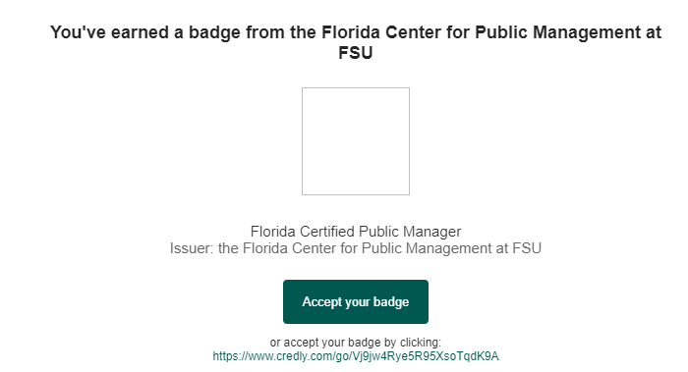

Here’s the email! It will say: The Florida Center for Public Management at FSU issued you a new badge:
Accept your badge and follow the instructions from Credly
to upload it to LinkedIn! It’s an easy way to connect with other CPMs!
Don’t see it? Check your spam for a message from CREDLY!

Slide 3
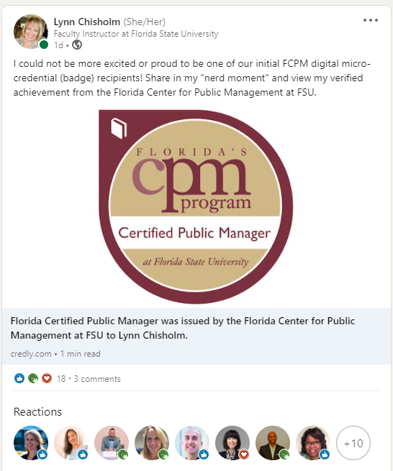
Share out your badge with a unique message promoting your professional “brand.”
Hashtag us so we can celebrate your accomplishment! #FCPM / #CPM
Connect with others to continue networking by using the #FCPM and a search for CPM grads!
Learn more at www.info.credly.com/resources!

Slide 4
Look for your email by Tuesday of next week…
Still not sure what to do?
CREDLY.COM is your best source of info to help troubleshoot!
Accept the badge and Credly will lead you through it.
If you’re really stuck – email Lynn at Lynn.Chisholm@fsu.edu

